Slide 1

PROJECT ON BANK ANALYTICS

Slide 2
Introduction
About :- Banking is one of the world's leading financial institutions, serving individuals, small- and middle-market businesses, large corporations, and governments with a full range of banking, investment management, and other financial and risk management products and services.
The primary goal of this project is to analyze the seasonality of financial data from 2007-2011 and create an adequate plans to know the total loan amount recovered and year-wise loan amount.
By analyzing customer data, the Bank can provide valuable insights into customer preferences of loans.
Bank loan of customers is a finance data of a bank. We have Datasets of Finance_1 & Finance_2 and each excel file has 39k+ records.

Slide 3
Overview of Given data
Total Customers – 39,717 customers
Total Loan Amount – $446 Million
Total Funded Amount - $435 Million
Total Revolving Balance - $535 Million
Total Payment Amount - $483 Million

Slide 4





DATA PROCESSING
1. Data Understanding: The key to success on any data project is through understanding of the data. As a result, we took the time to learn about bank data model and domain.
2. Data Cleaning: After learning about bank data, we cleaned up the accessible datasets and considered what an ideal dataset for this topic would look like.
3. Data Modelling: After confirming that the data was clean for analysis, we needed to process and model it into a dataset capable of precisely answering the business questions and producing the required outcomes.
4. Data Analysis : We used our analytical capabilities to identify insights from our new dataset and to create visualizations to describe the insights.
5. Uncover Insights:. Finally, we applied these insights for recommendations for next steps.

Slide 5
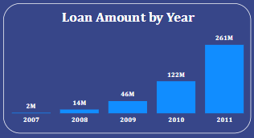
KPI 1 - Year wise loan amount Stats
In our first KPI we observed that from year 2007 to 2011 the loan amount gradually increased.
We found that bank has been charged off 448K Dollar amount in 2007 as the borrowers became delinquent on payments and this amount increased by 43 Million Dollar in 2011.
The analysis revealed that Debt Consolidation is the main purpose for loan in all the years.
The amount of fully paid loan status also increased from 1,731K Dollar (total loan amount =2.22M dollar) to 198M Dollar(total loan amount =261M dollar) gradually from 2007 to 2011.
By analysing the data we found that California, Florida, New Jersey, New York and Texas are the top 5 states which have taken maximum loan amount.
In 2011 there was 1,140 people who were paying current loan amount that is 19M Dollar.

Slide 6
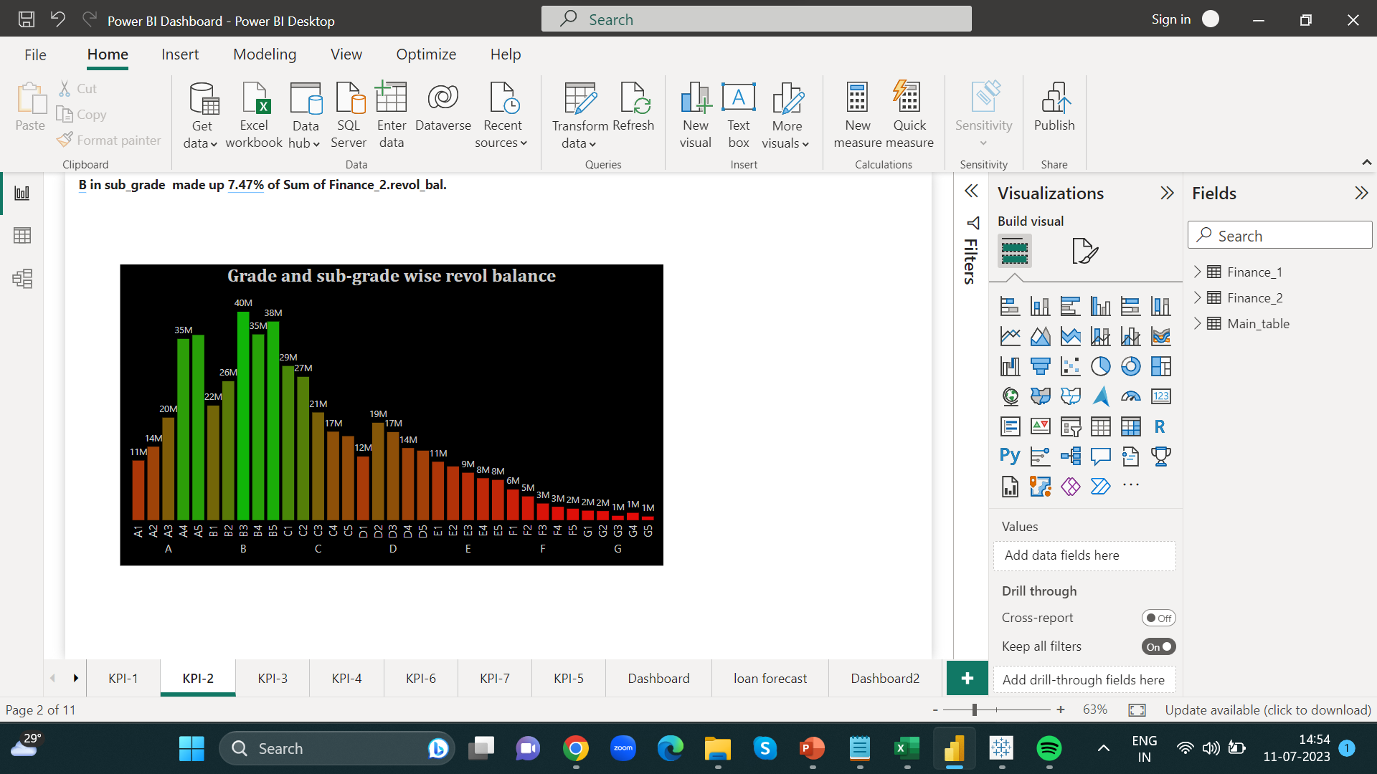
KPI 2 – Grade and sub-grade wise revolving balance
Loan grading is a classification system that involves assigning a quality score to a loan based on a borrower's credit history, quality of the collateral, and the likelihood of repayment of the principal and interest.
We found that Grade B has highest Revolving Balance whereas Grade G has lowest Revolving Balance.
For Grade B, the top 5 countries, which have highest revolving balance are California, Florida, New Jersey, New York, and Texas.
In year 2007 grade C sub-grade C3 showing highest revolving balance whereas in year 2011 grade B sb-grade B3 showing highest revolving balance.

Slide 7
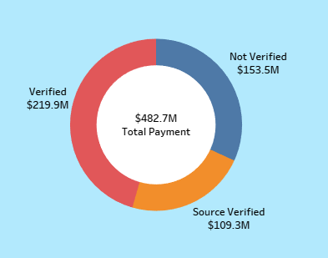
KPI 3 – Total Payment for verified status V/s non-verified status
﻿Sum of total payment for Verified status (219.89 M) was higher than Not Verified (153.54 M).
Year by year the percentage of verified status increased.
In 39,717 customer’s accounts, there are 16,921 customer’s accounts are verified and 12,809 customer’s accounts are still not verified.
To enhance lending practices and outcomes, it is recommended to concentrate on strategies such as implementing stricter verification process to increase the percentage of verified status.
California has the highest verified customers whereas Tennessee has lowest verified customers.

Slide 8
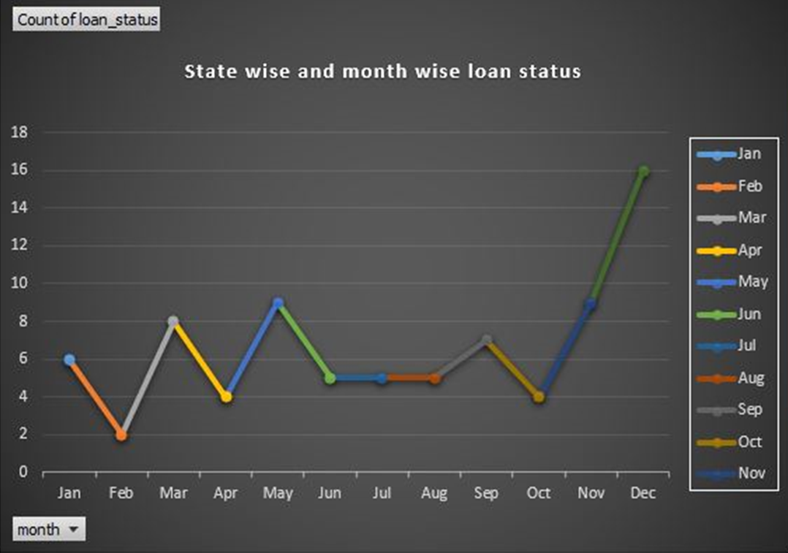
KPI 4 – State wise and last credit pull date wise loan status
From year 2007 to 2014 the count of loan status increased gradually but a down fall observed in year 2015 but in 2016 it highly increased.
By analysing the data we found that California, Florida, New Jersey, New York and Texas are the states which are showing maximum count of loan status.

Slide 9
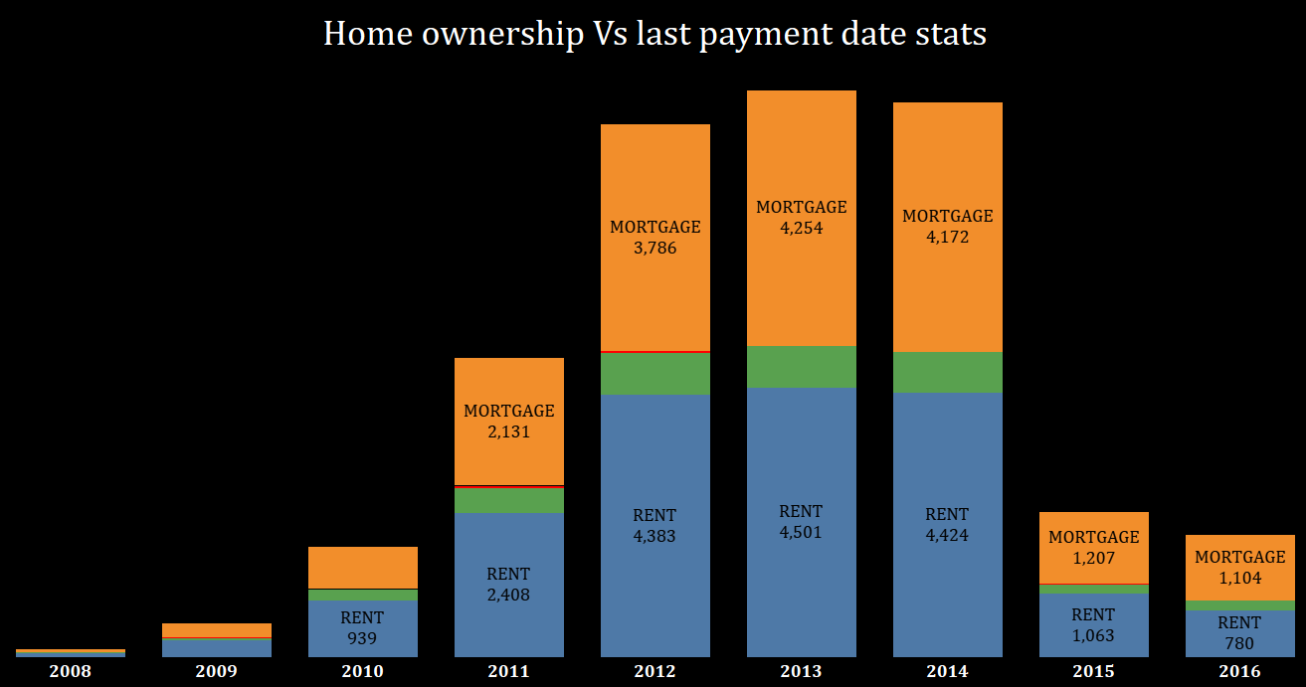
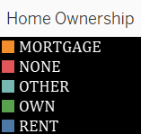
KPI 5 – Home ownership v/s last payment date stats
From 2008 to 2014, the count of home ownership loans increased gradually but from 2014 till 2016 the count started decreasing.
The analysis of data revealed that state California had highest count of Rent home ownership loan.
The acceptance of rent and mortgage loans are high in home ownership loans.

Slide 10
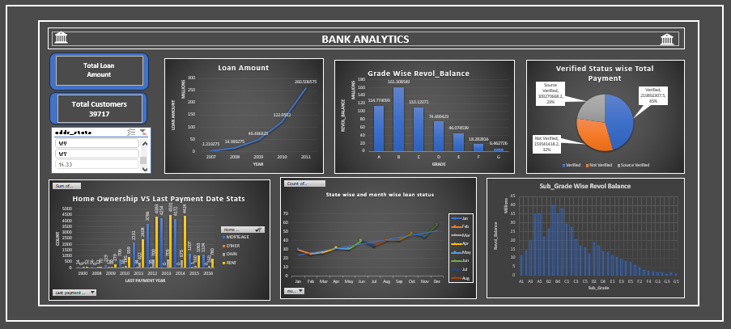
Excel Dashboard

Slide 11
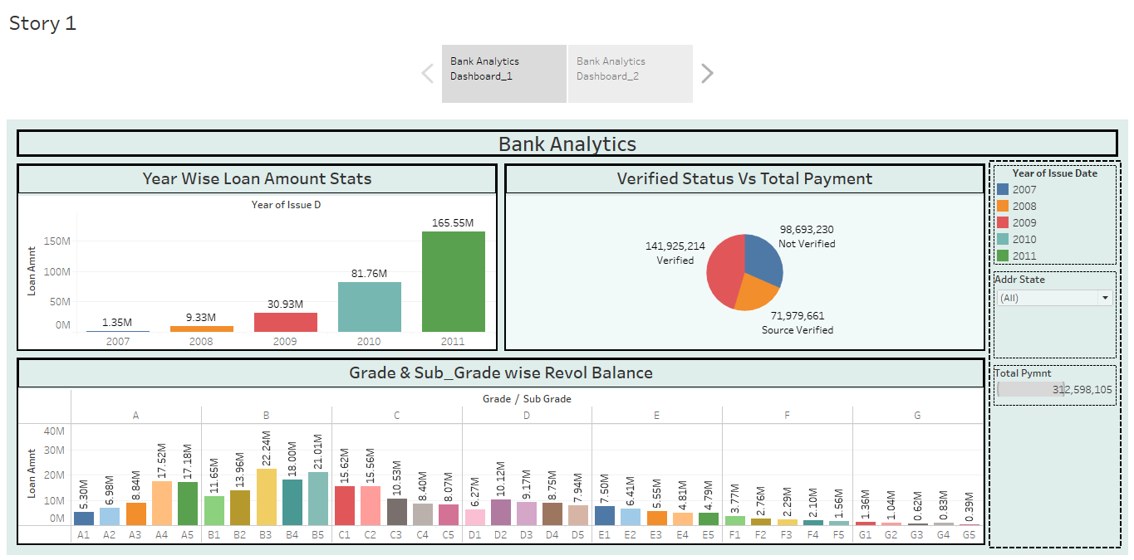
Tableau Dashboard

Slide 12
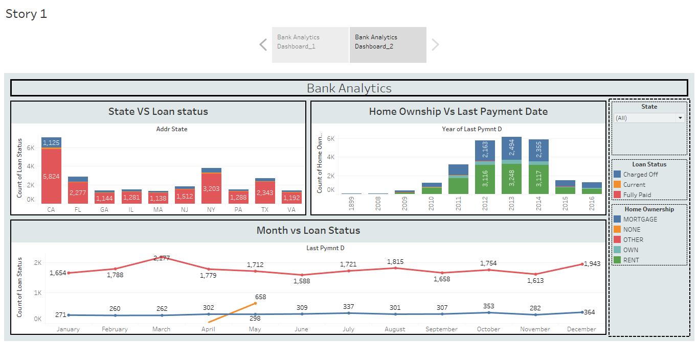
Tableau Dashboard

Slide 13
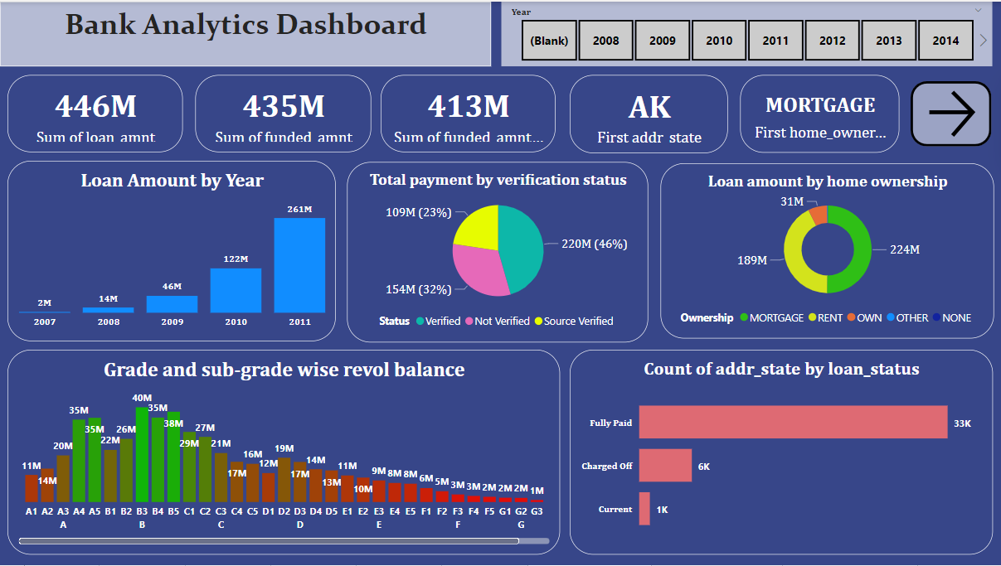
Power bi Dashboard

Slide 14
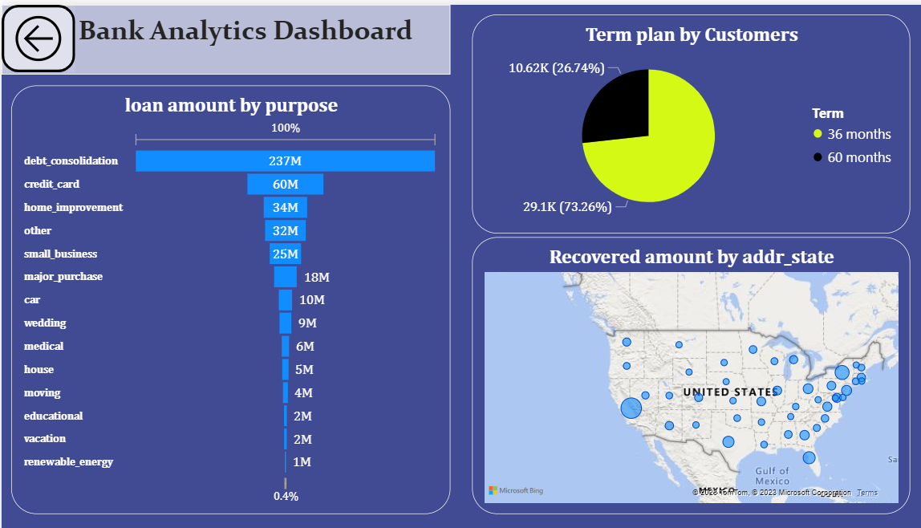
Power bi Dashboard

Slide 15
FINDINGS & SUGGESTIONs
Key findings include a gradual increase in loan amounts over time, Grade B having the highest revolving balance, a higher percentage of verified status compared to non-verified status, and the prevalence of renting and mortgage payments over outright home ownership.
Furthermore, the analysis revealed that California (CA) has emerged as the top contributor of loan payments, potentially due to its large population, diverse economy, and borrower financial responsibility. The top contributors to loan purposes were debt consolidation, credit card refinancing, and home Improvement
To enhance lending practices and outcomes, it is recommended to focus on strategies such as implementing stricter verification processes to increase the percentage of verified statuses.
By utilizing these insights, stakeholders can optimize risk management, support borrowers' financial goals, and foster a healthy lending environment.
This analysis highlights the significance of data analysis and insights in driving informed decision-making, improving loan performance, and meeting the needs of borrowers and lenders alike. By leveraging these insights, stakeholders can create a more robust and customer-centric lending ecosystem.

Slide 16
Team Members
Akash B B
Amruta S P
Amit K
P. Koushik Kumar Reddy
Saumya A P
Puja Kumari
Rutuja B G
S M Arifulla

Slide 17
Thank You

